Slide 1
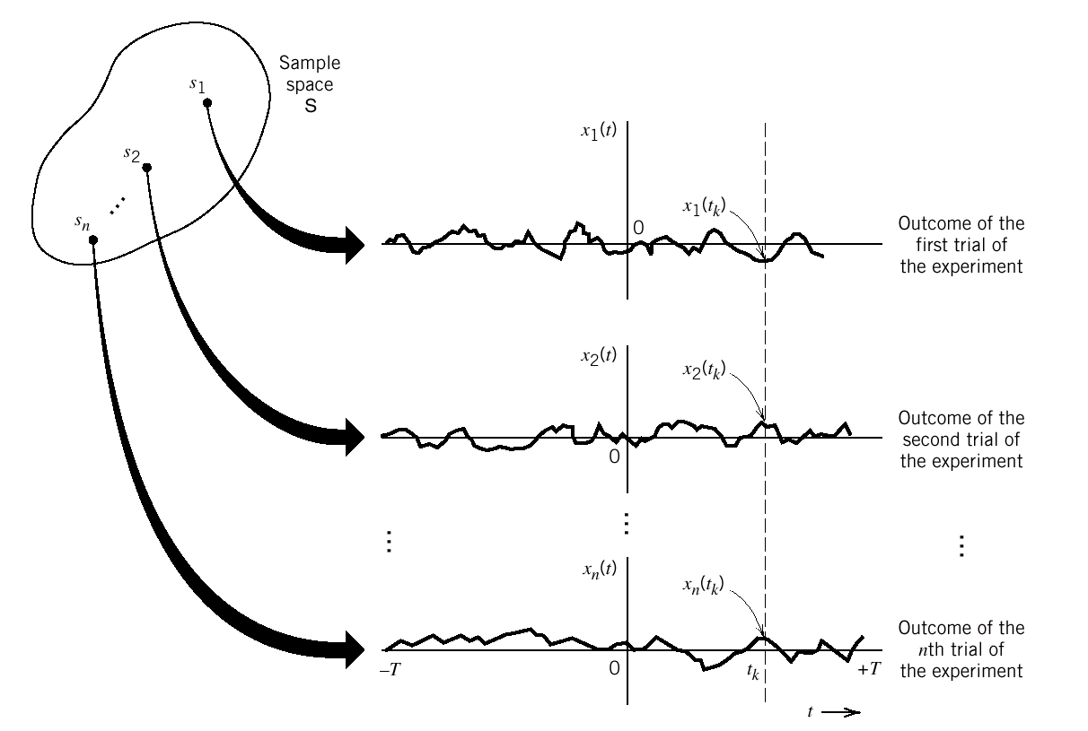
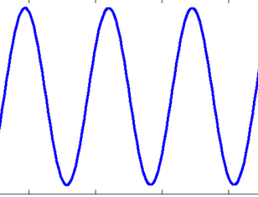
From Deterministic Signals
to Random Process
从确知信号 到随机信号：预备知识
确知信号
随机过程

Slide 2
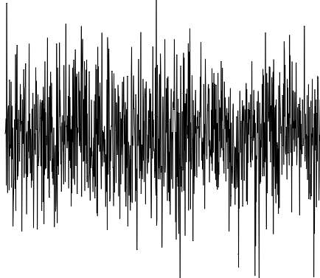


问题的引入
Source of
information
Transmitter
Channel
Receiver
User of
information
发送端
Noise
模拟信号：speech signal
random noise
In a communication system, not only the channel noise is a random process, but the useful signal carrying information is also a random process, for the message itself is inherently uncertain.
数字信号：binary random sequence

Slide 3
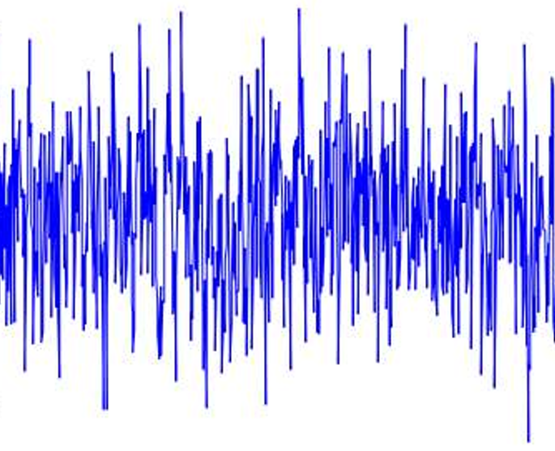
确知信号vs 随机过程
Comparison Dimension | Deterministic Signal | Random Signal (Random Process)
Core Nature | Definite function of time | Ensemble of sample functions; the value at each time instant is a random variable
Value at time t | At a given time instant t, the value is unique and deterministic, fully predictable | At a given time instant t, the value is a random variable; the instantaneous value cannot be predicted
Waveform Quantity | Only one unique deterministic waveform | Infinitely many sample‑waveforms; measurement yields only one of the samples

Slide 4
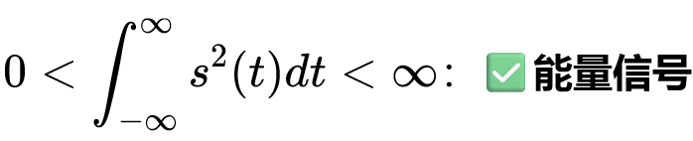
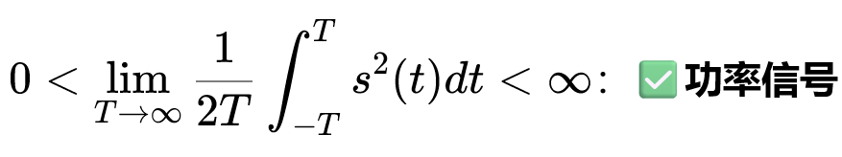
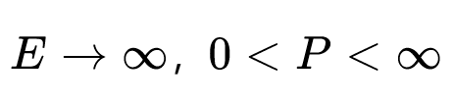
确知信号vs 随机过程
Comparison Dimension | Deterministic Signal | Random Signal (Random Process)
Energy / Power Signal | Integrate over the single unique waveform to classify as energy‑signal or power‑signal | Stationary random process is a power signal.Analyzed by means of power spectral density.
Description Method | Explicit time‑domain function s(t) | Characterized by probabilistic‑statistical quantities: mean value, variance, probability distribution and other statistical features. A single sample is insufficient for full characterization.
Predictability | Instantaneous value is fully predictable | Instantaneous value is unpredictable; statistical regularities can be characterized.

Slide 5
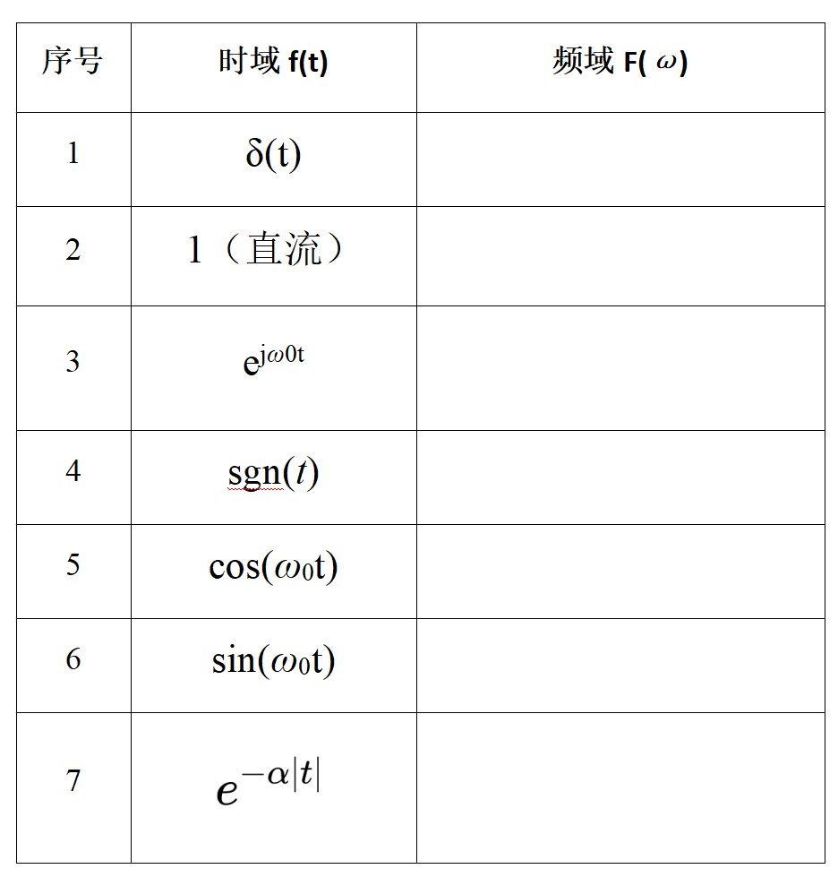
常用公式表

Slide 6
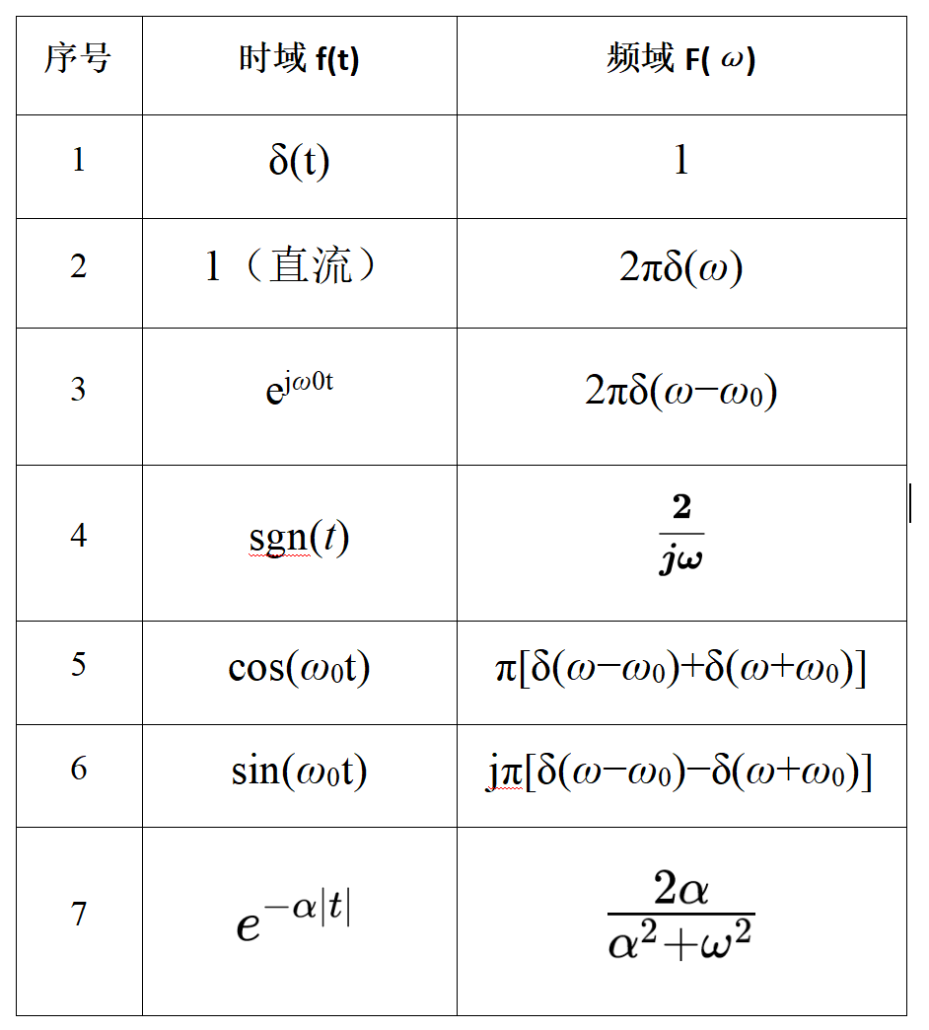
常用公式表

Slide 7
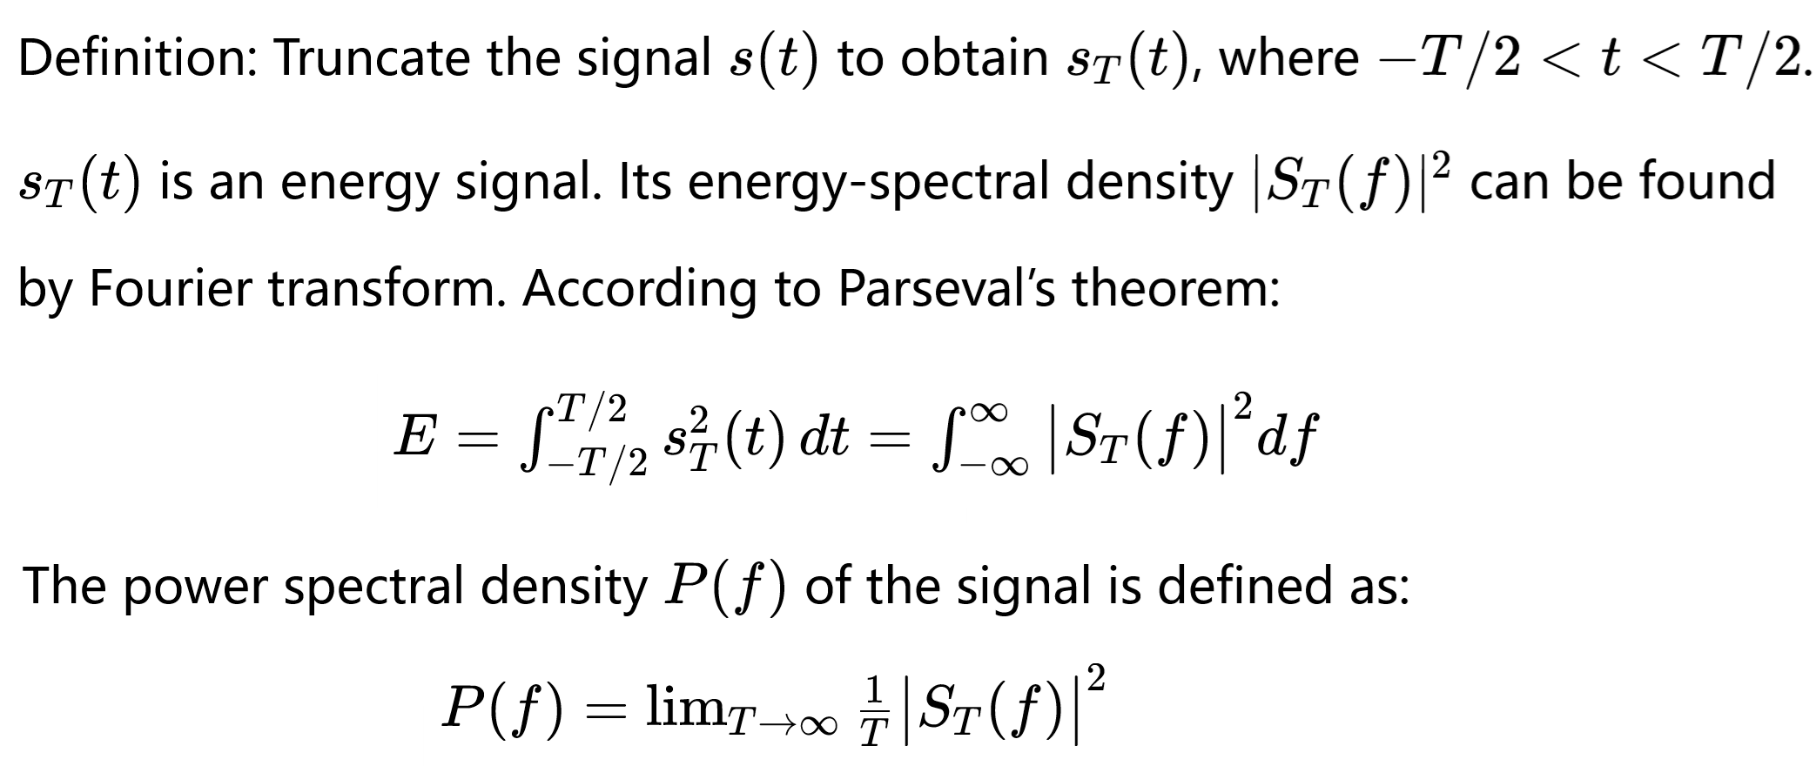
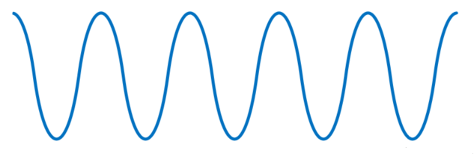
确知信号Power Spectral Density:PSD
截断
帕塞瓦尔定理：
时域频域能量守恒
s(t)
sT(t)

Slide 8
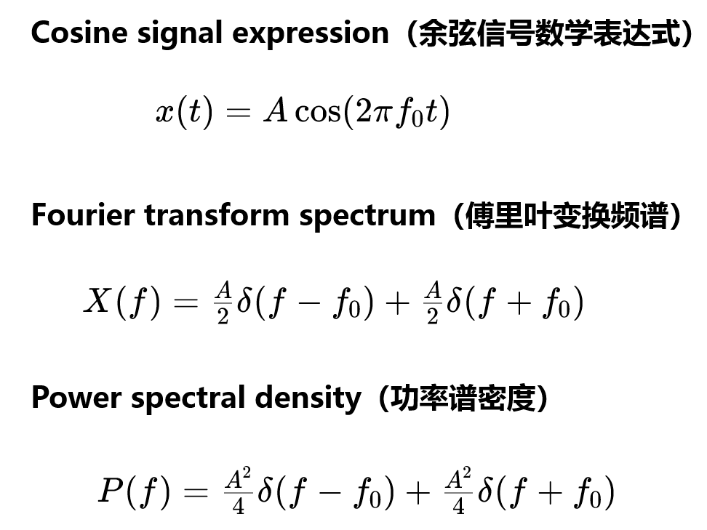
确知信号Power Spectral Density:PSD
In communication systems, we care about signal detection and SNR, which depend on power instead of instantaneous amplitude.
通信核心指标就是功率。
Power

Slide 9
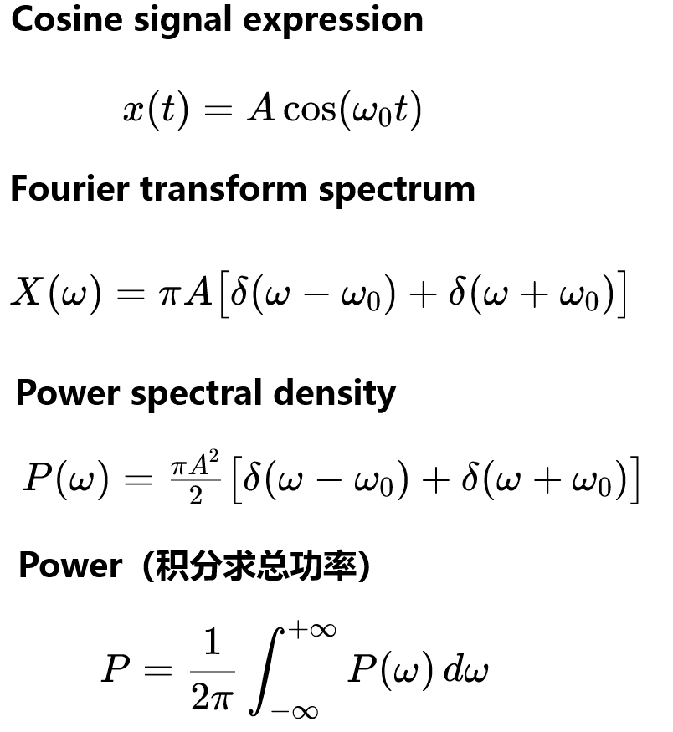
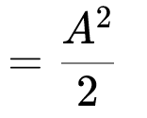

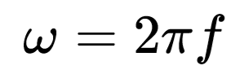
确知信号Power Spectral Density:PSD
In communication systems, we care about signal detection and SNR, which depend on power instead of instantaneous amplitude.
通信核心指标就是功率。
: angular frequency

Slide 10
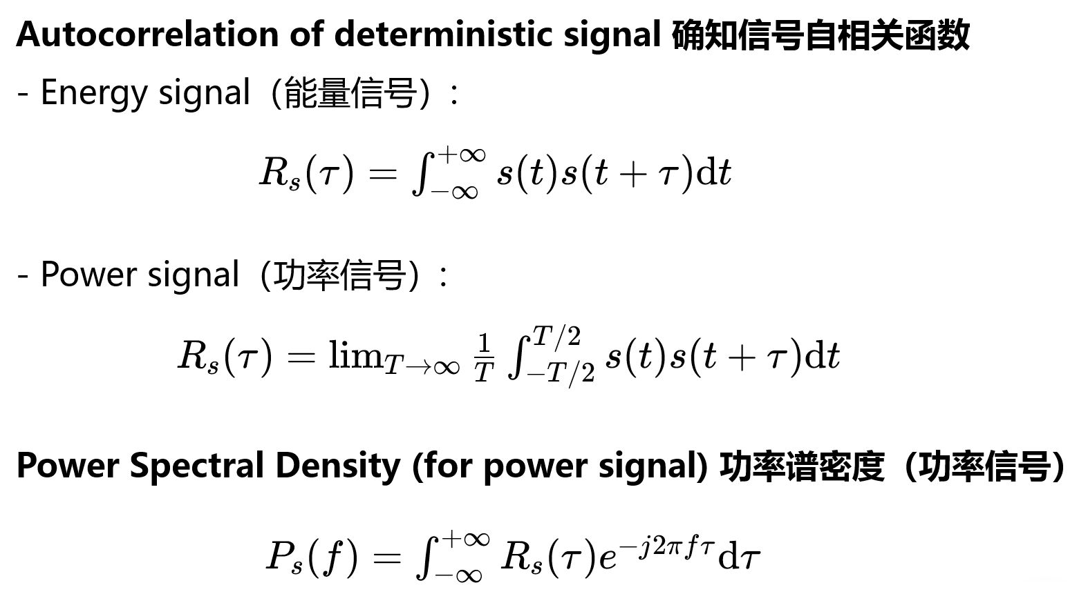
R(τ)和功率谱密度P(f)之间是傅里叶变换关系。

Slide 11
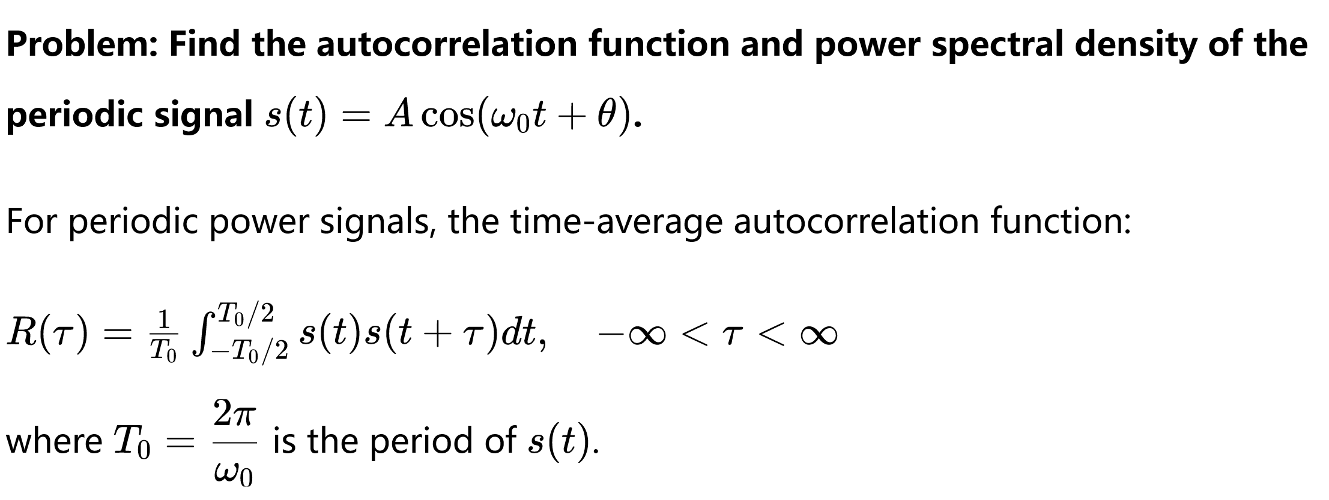
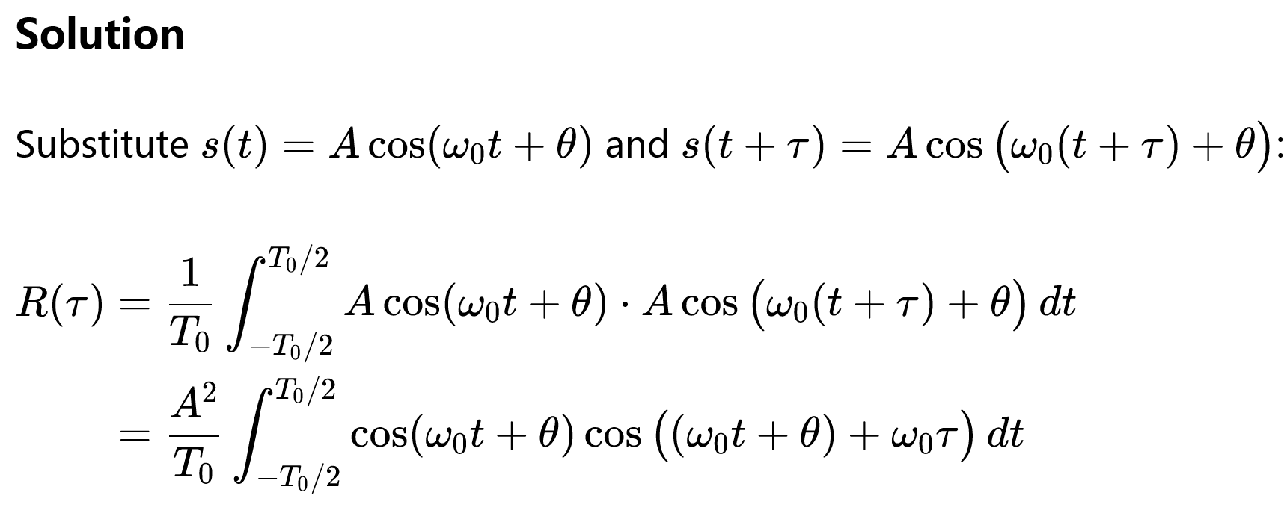

Slide 12
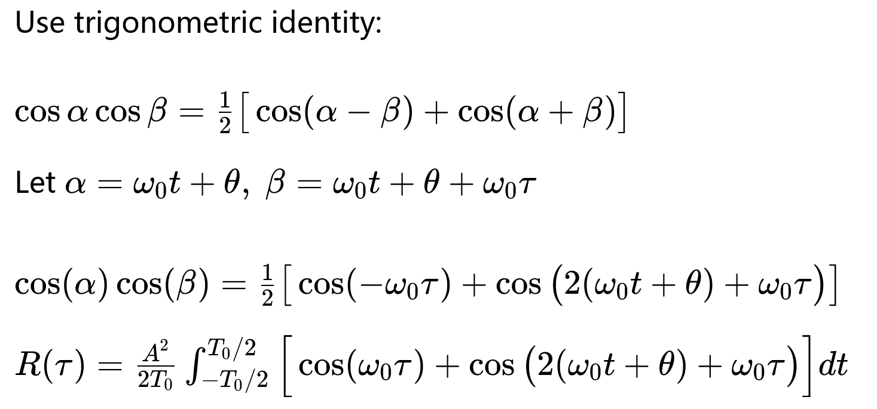

Slide 13
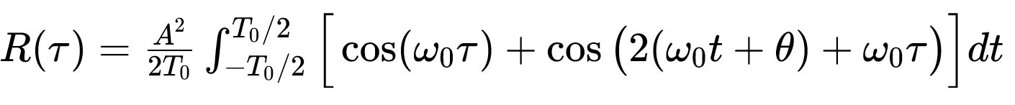
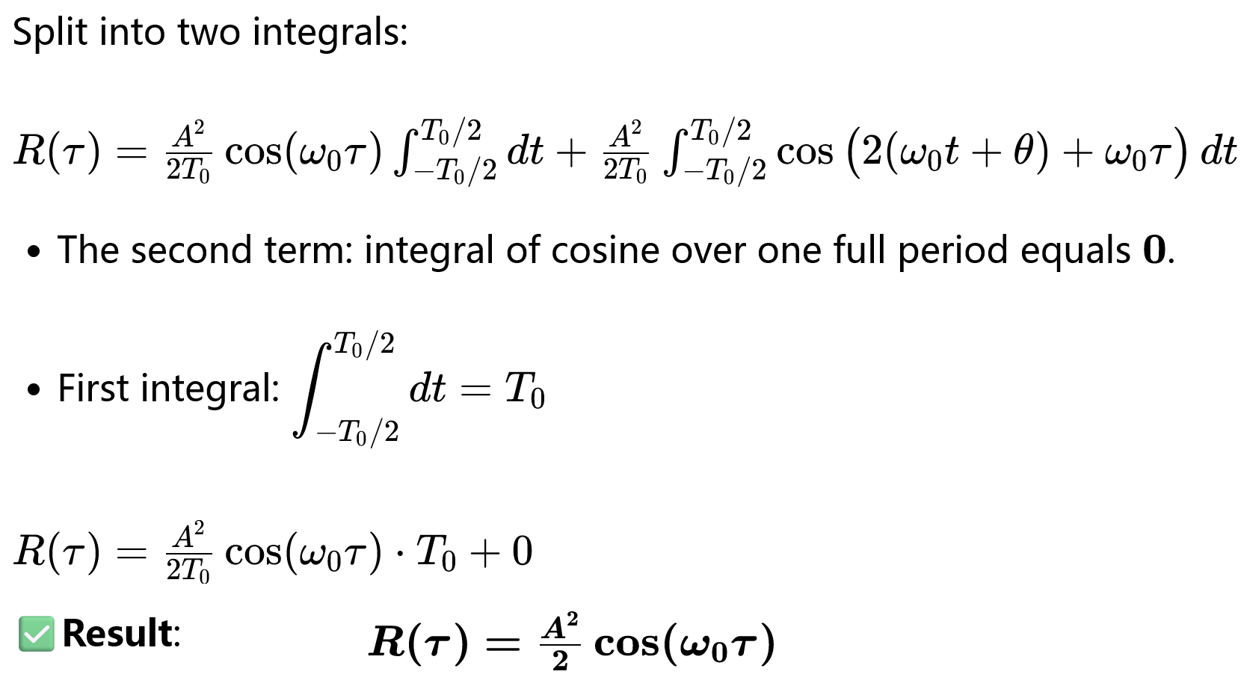

Slide 14
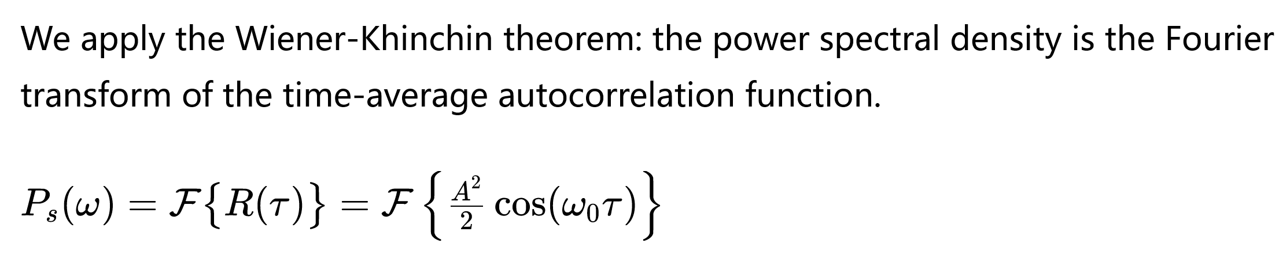
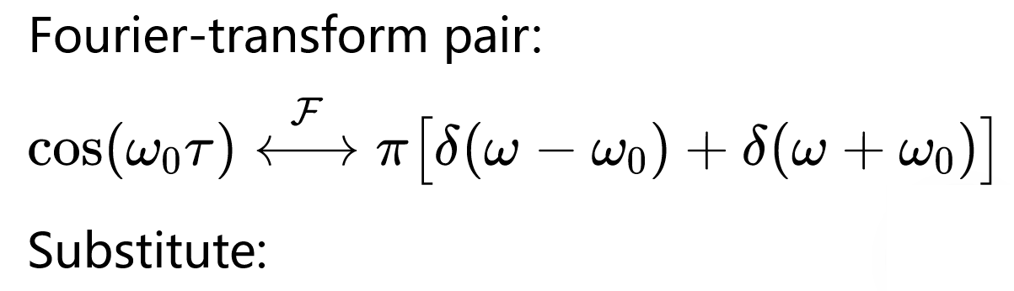
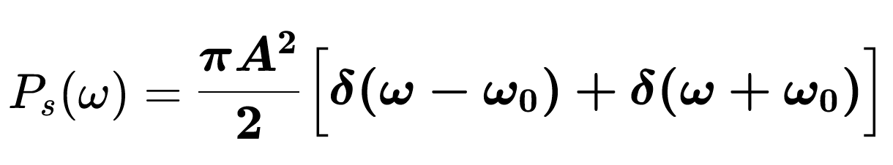

Slide 15
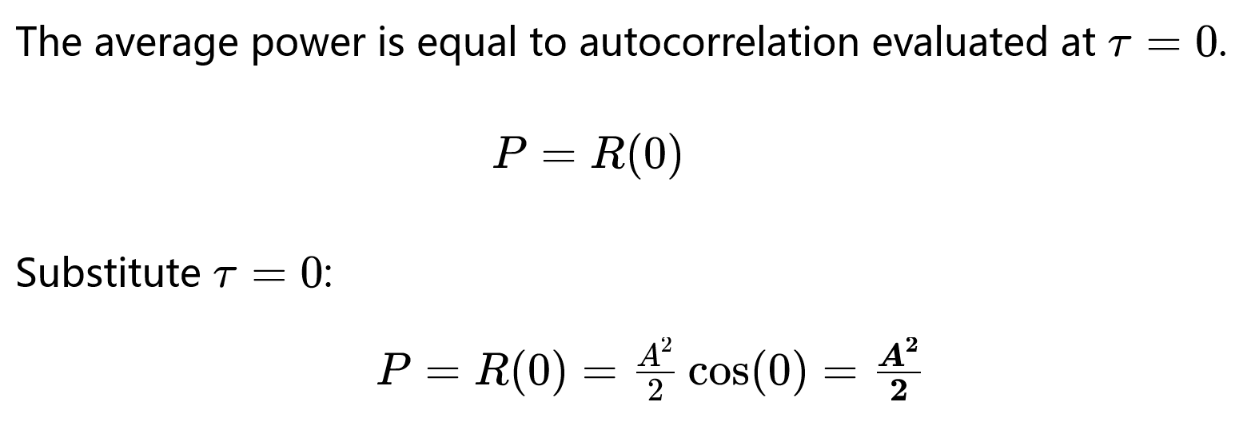

Slide 16
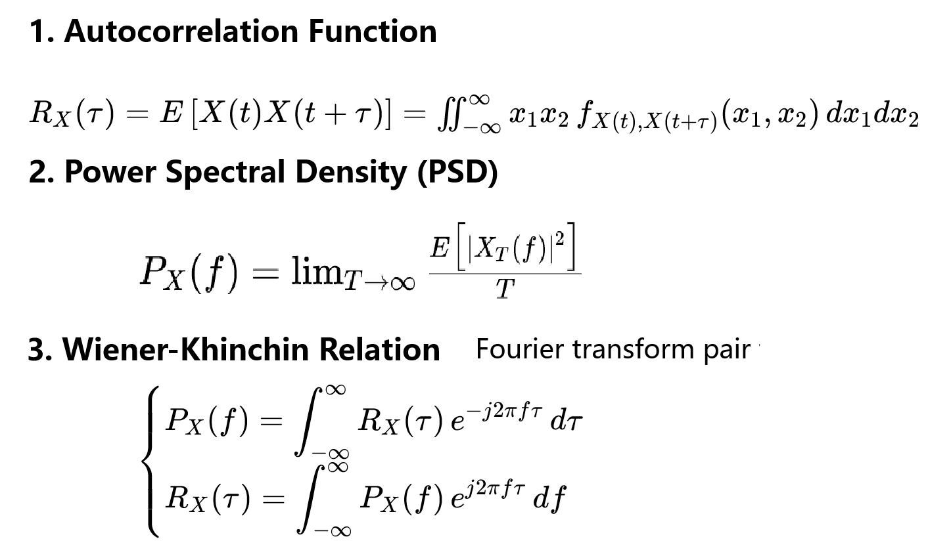
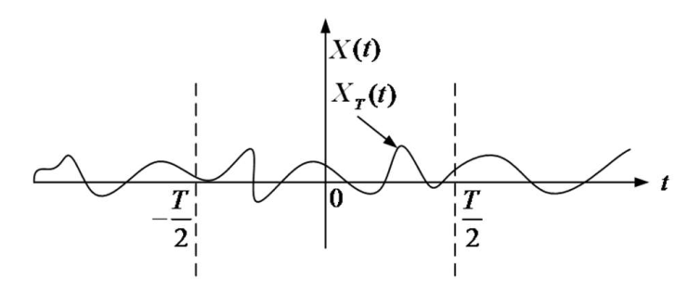

Wide-Sense Stationary Random Processes
广义平稳随机过程
维纳辛钦定理

